Slide 1
VSMUG – 2021-12 INtro
User Group Lead
Justin Chalfant
justin@patchmypc.com
Founder - Patch My PC
Twitter: @SetupConfigMgr
Virtual System Management User Group
Website: https://vsmug.com/
Content: https://vsmug.com/github
Twitter: @V_SMUG
YouTube: https://vsmug.com/youtube
Notes:
Basic intro for myself and the user group

Slide 2
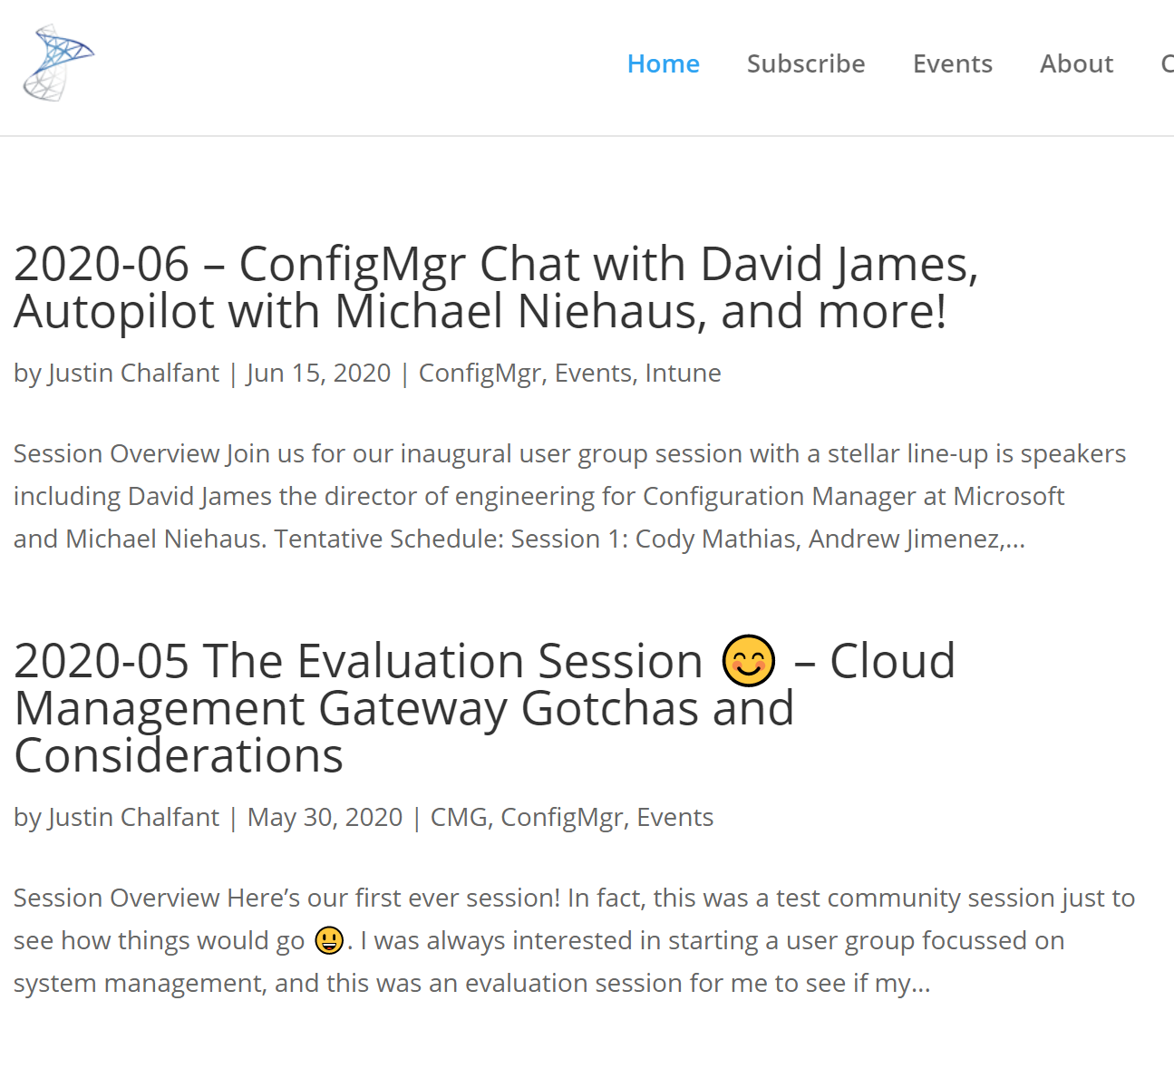
What is vsmug?
VSMUG Website & Social
https://vsmug.com/
https://vsmug.com/youtube
Twitter: @V_SMUG
Vsmug goal
The goal of the group is to share experiences and help all members become more involved and learn more about our field.
To get involved email me justin@patchmypc.com
Notes:
The goal of the group

Slide 3
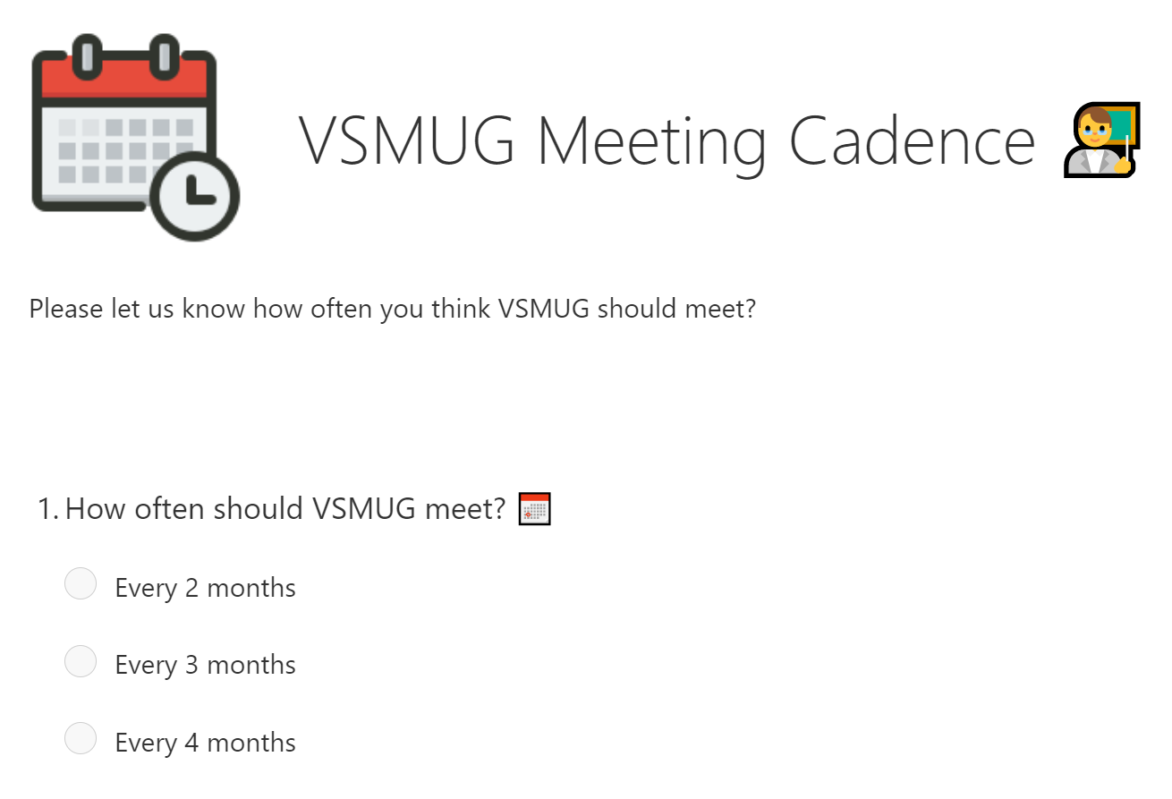

Go vote - Meeting cadence? 📅
Please go vote now! 👇
https://vsmug.com/vote
Or scan the QR code to vote! 📲
Notes:
Please vote on the cadence

Slide 4
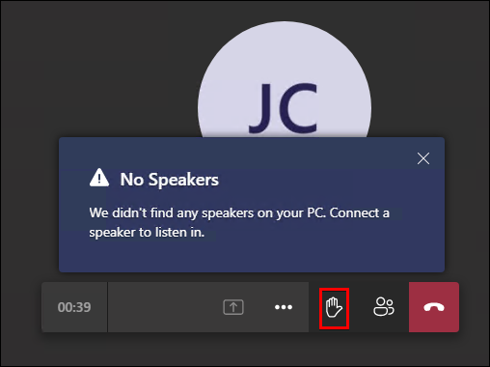
Team Meeting - Asking questions❓
Let’s keep it interactive
Ask questions
Use the chat feature to collaborate with everyone! 👋
We disabled audio and camera due to the number of attendees, but we will unmute for questions when using the Raise Hand feature!
Notes:
How to use a team's live event to ask questions

Slide 5


Submit a session
Submit a session! 👇
https://vsmug.com/session-submission
Or scan the QR Code
Notes:
Get involved, submit a session

Slide 6
VSMUG – 2021-12
User Group Lead
Justin Chalfant
justin@patchmypc.com
Patch My PC
Twitter: @SetupConfigMgr
Virtual System Management User Group
Website: https://vsmug.com/
Content: https://vsmug.com/github
Twitter: @V_SMUG
YouTube: https://vsmug.com/youtube

Slide 7
Top 10(?) Tips for Optimizing WSUS Performance and Reliability
Justin Chalfant
Cody Mathis
We can’t count

Slide 8

Its just that easy
3400 environments
Zero environments with a WSUS timeout during their last synchronization
WITH all three ConfigMgr WSUS maintenance options enabled
How we know?
WSUS Maintenance Configuration
How we communicated with customers to improve WSUS health
Notes:
How to adjust- https://docs.microsoft.com/en-us/sql/database-engine/configure-windows/server-memory-server-configuration-options?view=sql-server-ver15

Slide 9
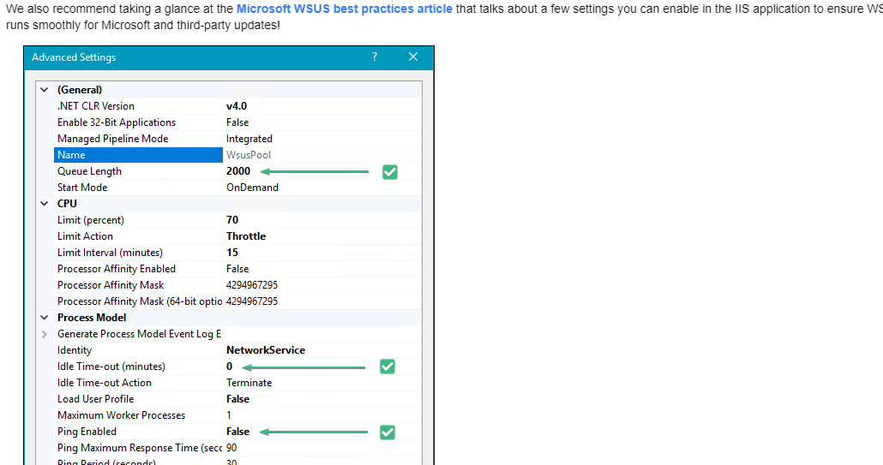
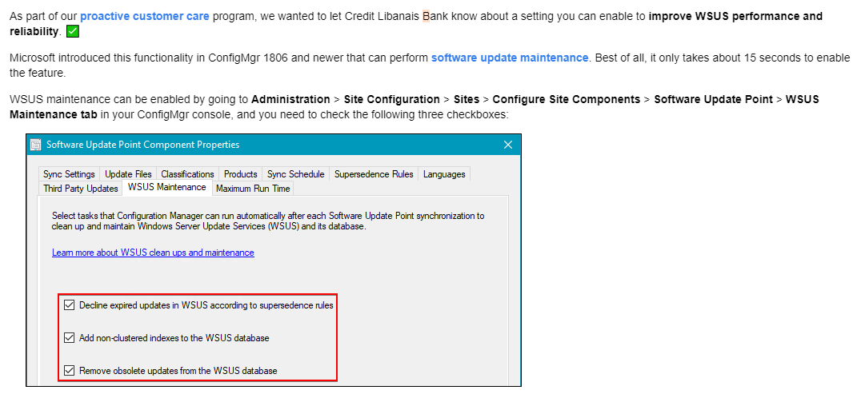
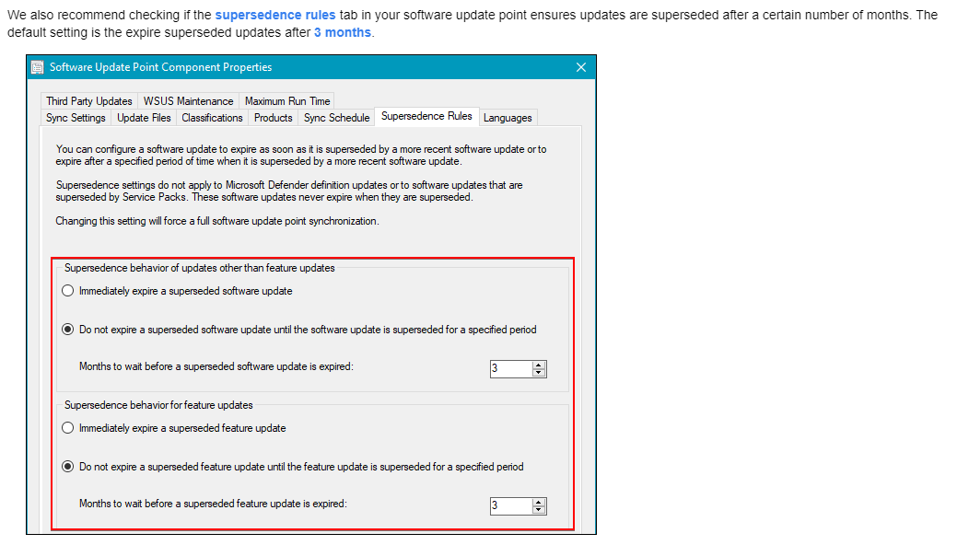
How we communicated
Notes:
How to adjust- https://docs.microsoft.com/en-us/sql/database-engine/configure-windows/server-memory-server-configuration-options?view=sql-server-ver15

Slide 10
SQL Memory
WID defaults to ‘unlimited’ SQL memory
Maybe not a big deal if this is a dedicated WSUS box
Shared SQL instance?
If SUSDB and CM_<SiteCode> are on the same instance they are sharing a memory pool
Low memory allocation can cause timeouts when querying WSUS
We had to drop this to 1gb to make things break 😁
Notes:
How to adjust- https://docs.microsoft.com/en-us/sql/database-engine/configure-windows/server-memory-server-configuration-options?view=sql-server-ver15

Slide 11
Demo – Justin
How to adjust SQL memory

Slide 12
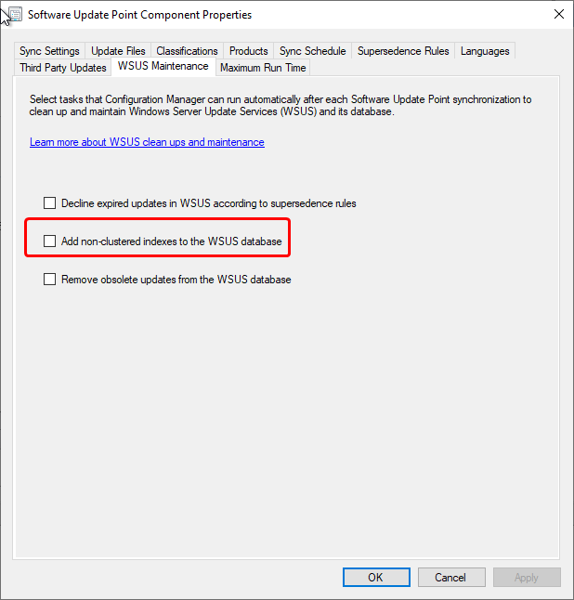
Create custom indexes (Configmgr)
ConfigMgr can create the indexes for you (probably)
Must have permission!
WID local to Site Server ✅
WID remote from Site Server ❌
SQL??? ✅
MS provides docs to add indexes manually
Chicken and egg!
Maintenance happens after the sync! And will not run in some failure scenarios such as a timeout when querying for all updates
Notes:
Create Indexes - https://docs.microsoft.com/en-us/troubleshoot/mem/configmgr/wsus-maintenance-guide#create-custom-indexes

Slide 13
Create custom indexes (manually)
-- Create custom index in tbLocalizedPropertyForRevision USE [SUSDB] CREATE NONCLUSTERED INDEX [nclLocalizedPropertyID] ON [dbo].[tbLocalizedPropertyForRevision] ( [LocalizedPropertyID] ASC )WITH (PAD_INDEX = OFF, STATISTICS_NORECOMPUTE = OFF, SORT_IN_TEMPDB = OFF, DROP_EXISTING = OFF, ONLINE = OFF, ALLOW_ROW_LOCKS = ON, ALLOW_PAGE_LOCKS = ON) ON [PRIMARY] -- Create custom index in tbRevisionSupersedesUpdate CREATE NONCLUSTERED INDEX [nclSupercededUpdateID] ON [dbo].[tbRevisionSupersedesUpdate] ( [SupersededUpdateID] ASC )WITH (PAD_INDEX = OFF, STATISTICS_NORECOMPUTE = OFF, SORT_IN_TEMPDB = OFF, DROP_EXISTING = OFF, ONLINE = OFF, ALLOW_ROW_LOCKS = ON, ALLOW_PAGE_LOCKS = ON) ON [PRIMARY]

Slide 14
Demo – Cody Why are indexes important?
Notes:
show stored procedure for exec spGetAllUpdates
joins on vwMinimalUpdate which references revision tables which lack indexes
the index itself.... CREATE NONCLUSTERED INDEX [nclSupercededUpdateID] ON [dbo].[tbRevisionSupersedesUpdate]

Slide 15
Actually running indexing
Creating the indexes is a one-off operation
Running re-indexing is an ongoing operation that should happen on a schedule
Microsoft provides T-SQL that can be set up as a SQL job that the SQL server agent will execute
If it is a WID then get creative!
Scheduled task
If it is a SQL instance then… use the tools provided
Maintenance Plan

Slide 16
Demo(3) – Justin
Basic maintenance plan

Slide 17
Decline unneeded updates
Clients scan against all non-declined updates in WSUS
Superseded updates are generally not needed
ConfigMgr WSUS maintenance can remove these
Community solutions / MS solutions if standalone WSUS
Updates have a ‘size’ for their metadata
Decline unused ‘large’ updates
More updates = longer scans = more WSUS resource usage
Notes:
Decline unused ‘large’ updates - https://tcsmug.org/blogs/jeff-carreon/513-what-s-sup

Slide 18
First time sync without updates Declined
Notes:
Decline unused ‘large’ updates - https://tcsmug.org/blogs/jeff-carreon/513-what-s-sup

Slide 19
Demo(1) – Cody
Large metadata updates
General WSUS update maintenance

Slide 20
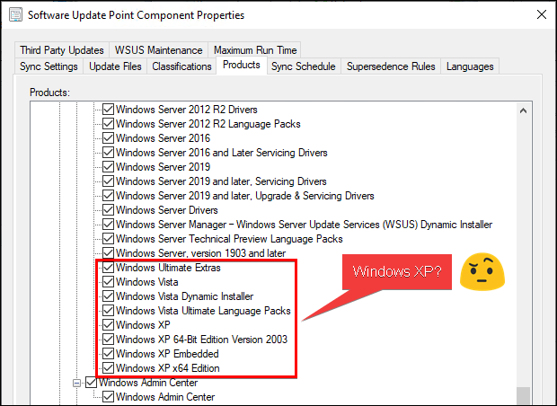
CHECK YOUR ENABLED CATEGORIES / PRODUCTS
Review the products enabled in the SUP ✅
Don’t check everything in most case ❌
e.g. - You probably don’t have XP running?
Notes:
Decline unused ‘large’ updates - https://tcsmug.org/blogs/jeff-carreon/513-what-s-sup

Slide 21
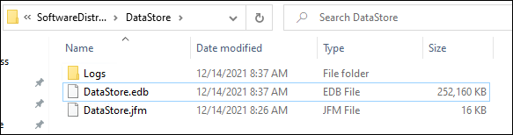
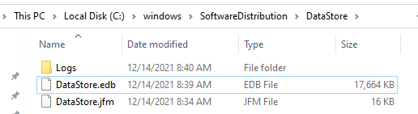
Client Database Comparison
Example of client-side DataStore.ebd file for full catalog enabled with no cleanup
Example of client-side DataStore.ebd file for maintained catalog
Notes:
Decline unused ‘large’ updates - https://tcsmug.org/blogs/jeff-carreon/513-what-s-sup

Slide 22
Demo(1) – Justin
Catalog size on endpoint

Slide 23
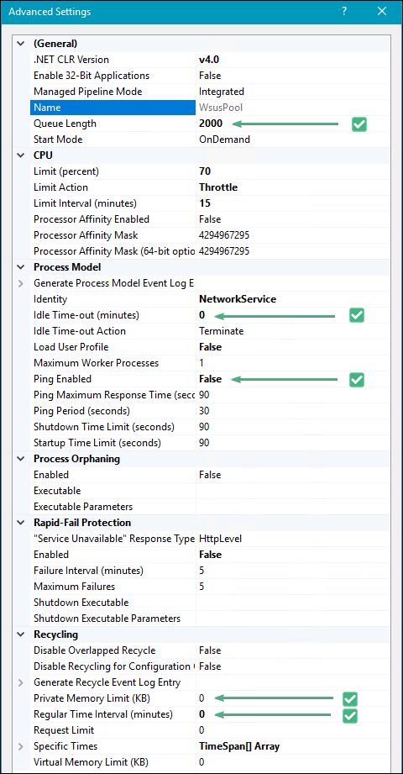
IIS Configuration
The defaults are not great
Queue Length 2000 (up from default of 1000)
Bigger env may need larger queue length
When limit is reached you receive a 503
Idle Time-out (minutes) 0 (down from the default of 20)
Windows will kill the IIS worker if no request in 20 minutes. We don’t really want to keep spinning this up… keep it ready
Ping Enabled False (from default of True)
This is not ICMP ping, this is IIS ‘ping’ that can cause an app reset recycle if it fails. We know WSUS gets hung up, don’t recycle the pool…
Private Memory Limit (KB) 0 (unlimited, up from the default of 1,843,200 KB)
Keep in mind what else is on the server
Regular Time Interval (minutes) 0 (to prevent a recycle, and modified from the default of 1740)
By default app pool recycles every 29 hours!

Slide 24
Demo – Cody
IIS Wonderland

Slide 25
Demo(4) – Justin
SQL Profiler

Slide 27
Section Header
This is the next section

Slide 28
Title
Line1
Bullet Level 1
Bullet Level 2
Bullet Level 3

Slide 29
Title
Code

Slide 30
Text Only with Border
Level 1
Level 2
Level 3

Slide 31
Text Only (Red)
Level 1
Level 2
Level 3

Slide 32
Title
Text 1
Level 1
Level 2
Level 3
Text 2
Level 1
Level 2
Level 3

Slide 33
Title
Section 1
Section 2
Text
Level 1
Level 2
Level 3
Text
Level 1
Level 2
Level 3

Slide 34
Demo Title

Slide 35





























Slide 36






























Slide 37




























Slide 38




























Slide 39




























Slide 40




























Slide 41




























Slide 42























Slide 43
















